Slide 1
CIA 3203 - Pong Project
Faisal Abdullah H00293910
Ahmed Osama H00277820
Abdullah Obaid H00329285

Slide 2

About the Game
Pong is a game similar to tennis, where two players compete to get the ball hit the other’s player side. The first player controls the first bar by pressing W to go up, and S to go down, while the second player controls the second bar by pressing up arrow to go up and down arrow to go down. It can also be played in single player. If the second player does not press up arrow or down arrow, then the second bar will be controlled by an A.I.

Slide 3

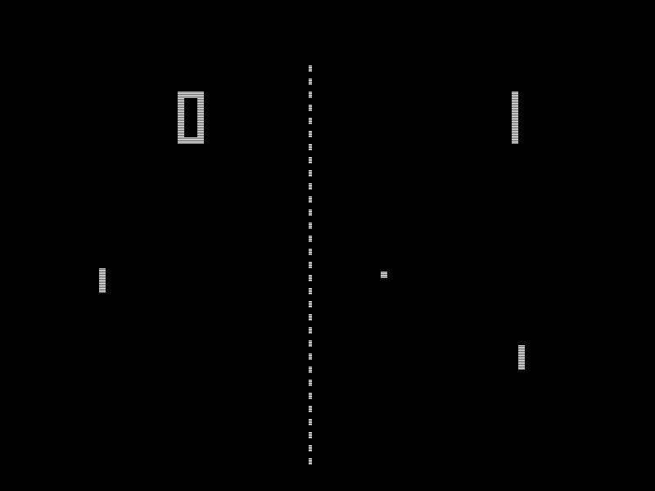
History of the Game
Pong is a game that was released in 29 November, 1972. It was developed by Allan Alcorn who was working in Atari. It was the first game developed by Atari. The idea behind Pong video game belongs to Nolan Bushnell, who assigned Allan Alcorn to the Pong project.

Slide 4
Levels and Level Progression
Level 1: Score required to win level: 3 Ball speed: 1.5 pixel per second. Score against the player to make him lose: 3 Bar height: 100
Level 2: Score required to win level: 4 Ball speed: 2.5 pixels per second. Score against the player to make him lose: 2 Bar height: 80
Level 3:
Score required to win level: 5 Ball speed: 3.5 pixels per second. Score against the player to make him lose: 1 Bar height: 60
If the player scores 3 balls in level 1 without losing, then the player moves from level 1 to level 2.
If the player scores 4 balls in level 2 without losing, then the player moves from level 2 to level 3.
If the player scores 5 balls in level 3 without losing, then the player wins the game.

Slide 5
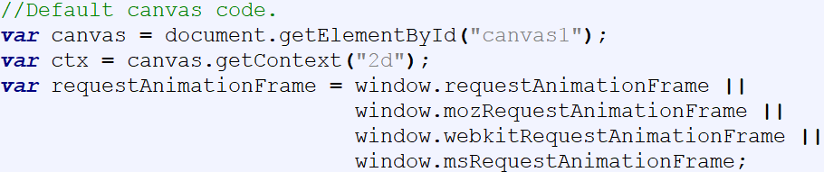
Default Canvas Code

Slide 6
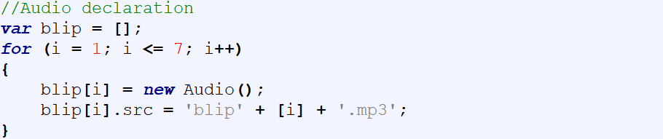

Audio Declaration

Slide 7
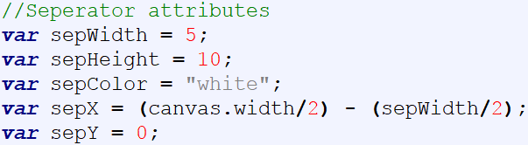

Separator Attributes

Slide 8
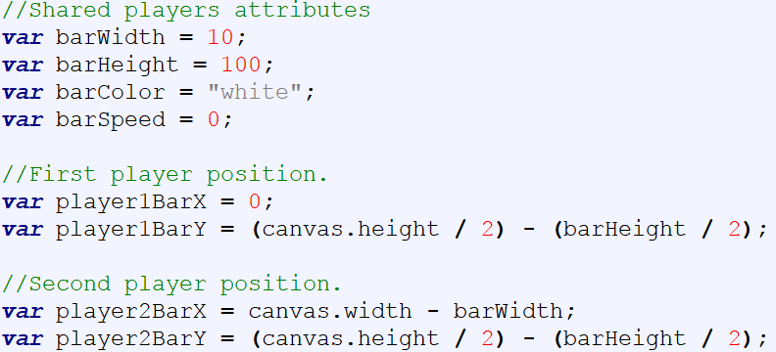
Bar Attributes

Slide 9
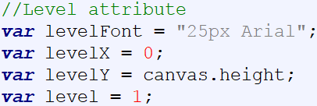

Level Attributes

Slide 10
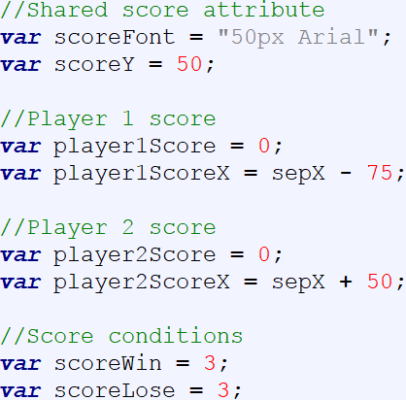

Score Attributes

Slide 11
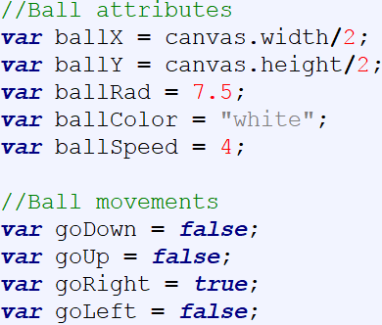

Ball Attributes

Slide 12
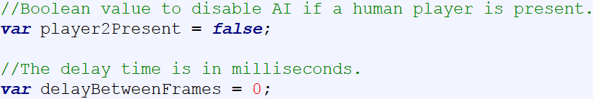
Other Attributes

Slide 13
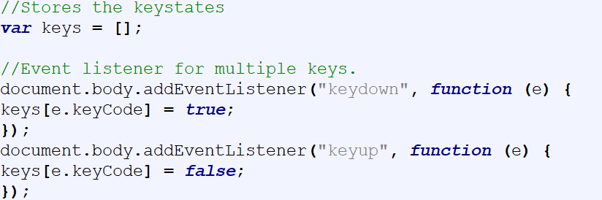
Event Listener - New vs. Old

Slide 14
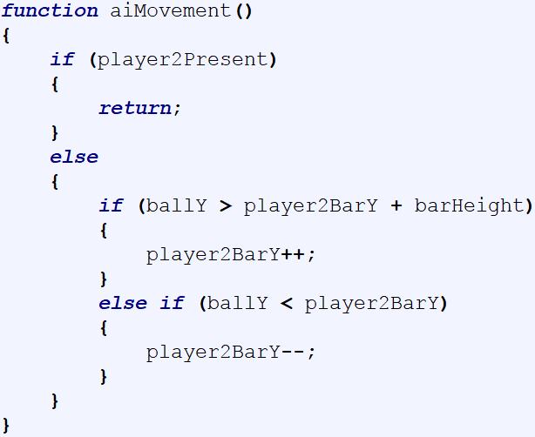
A.I Movement

Slide 15
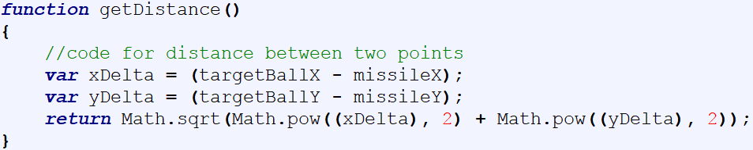
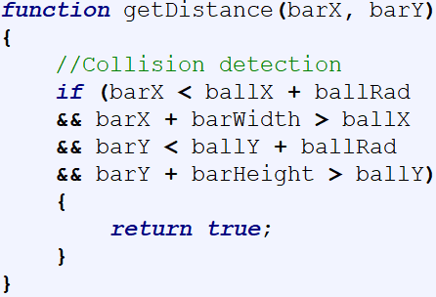
Calculating Distance

Slide 16
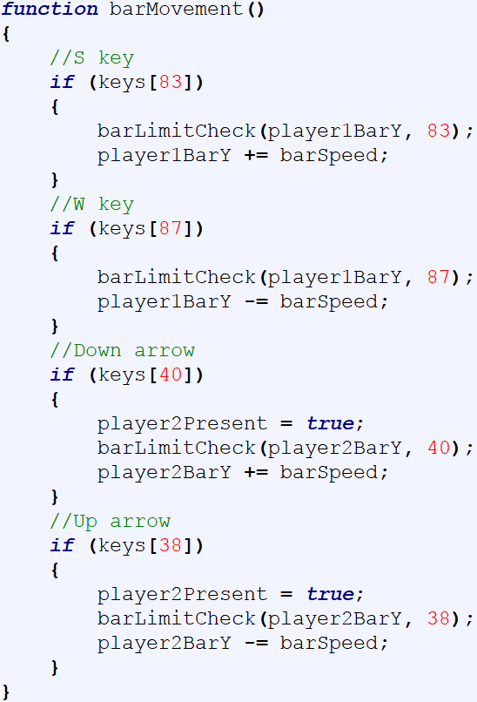
Bar Movement

Slide 17
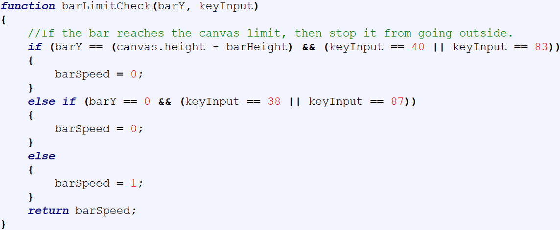
Check If Bar Hit Canvas Limit

Slide 18
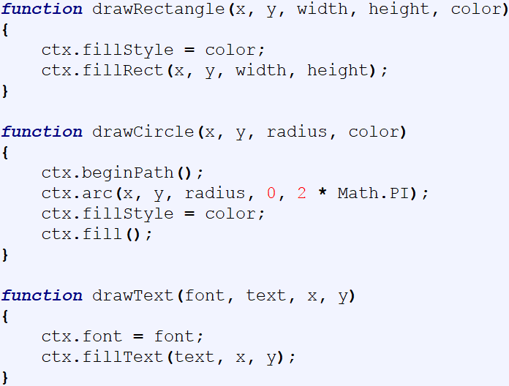
Draw Rectangles, Circles and Texts

Slide 19
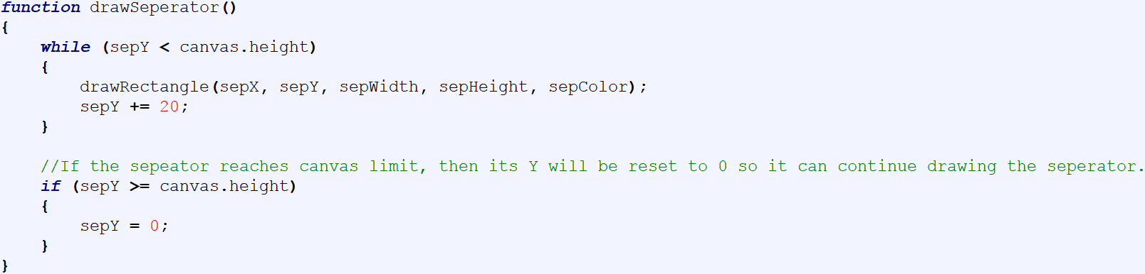
Draw Separator

Slide 20
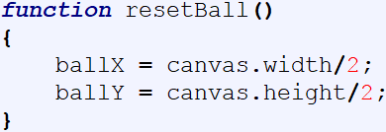
Reset Ball

Slide 21
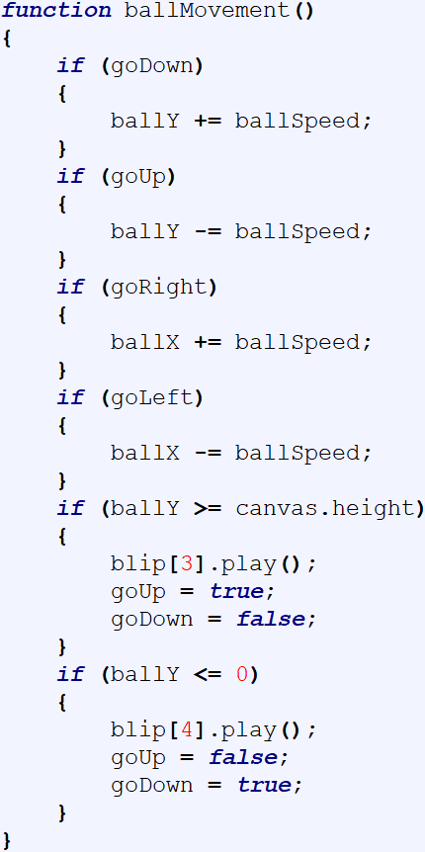
Ball Movement

Slide 22
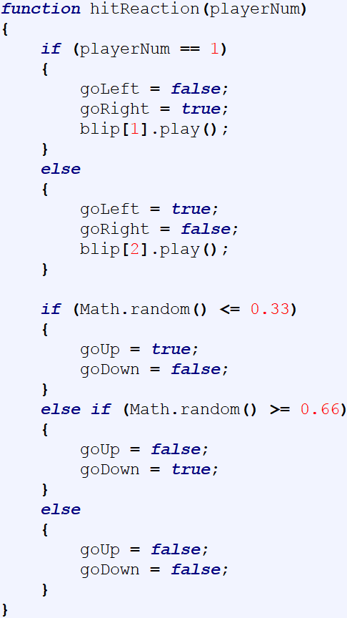
Hit Reaction

Slide 23
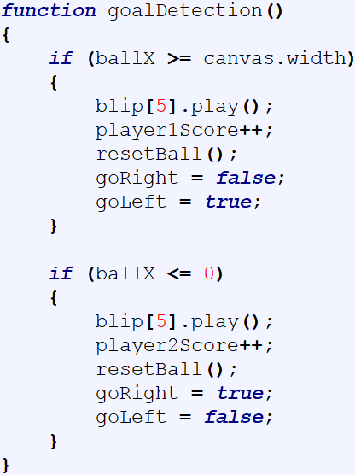
Goal Detection

Slide 24
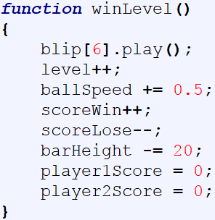
Win Level

Slide 25
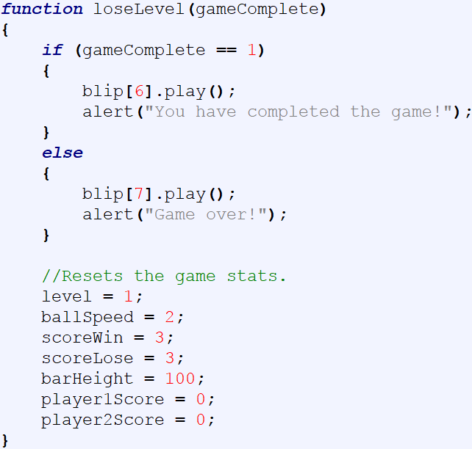
Lose Level

Slide 26
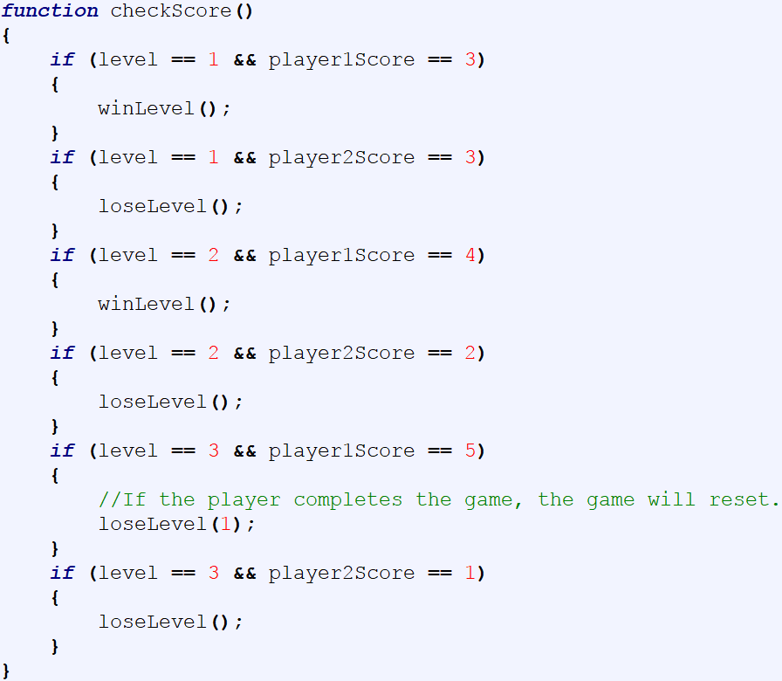
Check Score

Slide 27
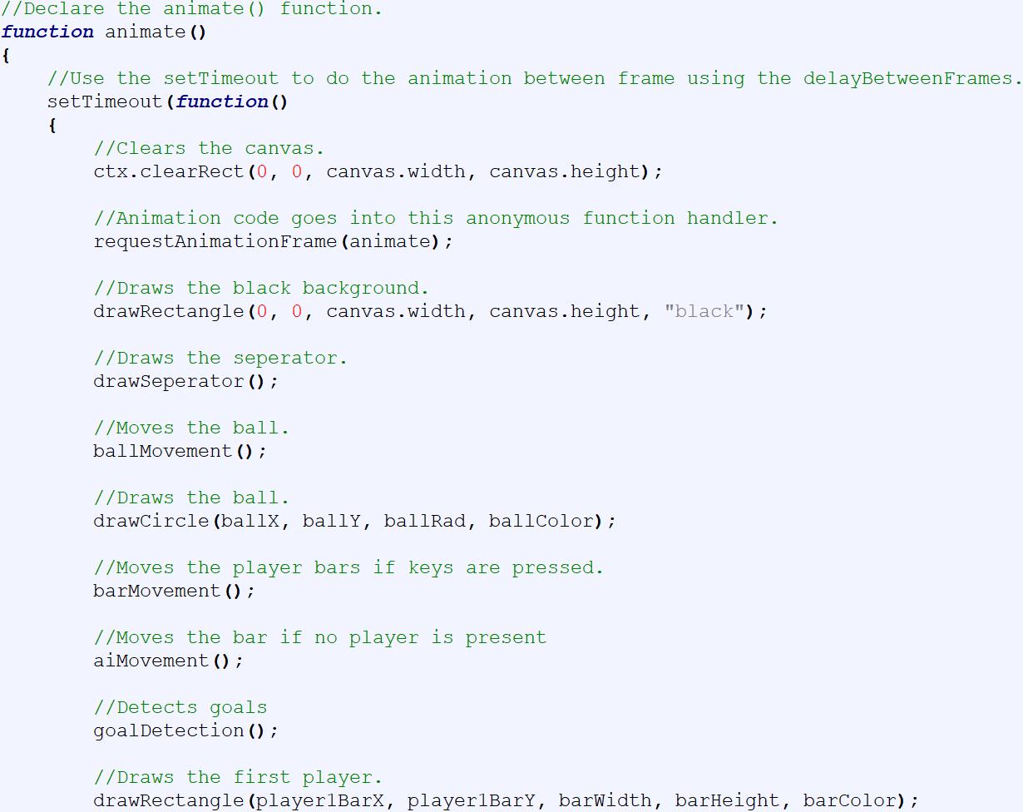
Call Functions (1)

Slide 28
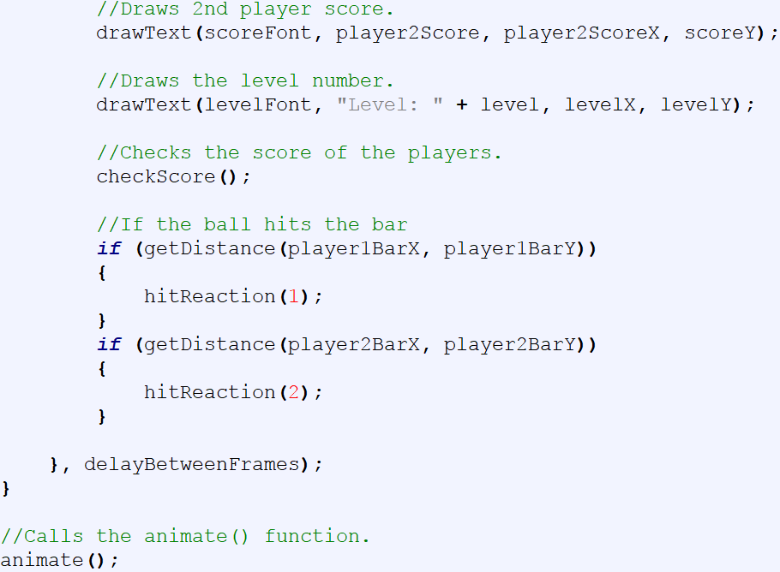
Call Functions (2)

Slide 29
References
"And Then There Was Pong". Ultimate History of Video Games. Three Rivers Press. pp. 38–39. ISBN 0-7615-3643-4.
Shea, Cam (10 March 2008). "Al Alcorn Interview". IGN. Retrieved 13 October 2008.
"This Day in History: November 29". Computer History Museum. Retrieved 28 November 2011.

Slide 30
Thank you for Listening
Any questions?

